Slide 1

SUBMITTED TO : DR. MOHAN BA
JAVA PROJECT
SUBMITTED BY :
SHIRSH AGRAWAL 1NT18CS217
SAJAN POUDEL 1NT18CS202
HARI OM NARAYAN 1NT18CS050

Slide 2



UEFA NEWS
FOOTBALL INFORMATION AND UPDATES

Slide 3

ABSTRACT
For a football fan in India it is difficult to keep up with the European football competitions. With such a tight fixture schedule and so many matches happening together and mostly after midnight it is almost impossible to know everything that’s going on and that’s where our “ football news application” comes into play.

Slide 4
FEATURES
Our application will have the following features:
It will consist of an admin panel where by entering your login credentials you will be able to update the latest matchday info.
It will also consist of a europa league category where you will be displayed all the matches as per the matchdays and their respective scorelines along with the goal scorers.
And finally it consists of a champions league category where you will be displayed all the matches as per the matchdays and their respective scorelines along with the goal scorers.

Slide 5
OBJECTIVES
To enable user to keep track of their favourite teams.
To help the user to know all the goal scorers.
To enable the admins to update the news anytime.
User will be able to know about all the biggest matches in Europe.
To pre-plan their activities accordingly to watch the match after seeing the schedule on our application.

Slide 6
PROBLEM STATEMENT
It is hard to keep up with European football I.e UEFA Competitions for everyone as there are a lot of matches going on at a time and mostly after the midnight in I.S.T. This is a huge problem for the football fans who seek reliable information at the earliest.

Slide 7
Lots of matches happen and have happened so to keep track becomes difficult and to get information in a sorted and a proper manner also becomes increasingly difficult if specially the matches have already been played that is information on past matches.

Slide 8
RESEARCH MOTIVATION
The motivation behind the research was that for a football fan in India it is difficult to keep up with the European football competitions. With such a tight fixture schedule and so many matches happening together and mostly after midnight it is almost impossible to know everything that’s going on and that’s where our “ football news application” ‘UEFA News’ comes into play.
This application will be a huge help to all the football fans in India as they will be able to keep track of all the football matches going on and track their favourite teams performances as well as other teams.

Slide 9
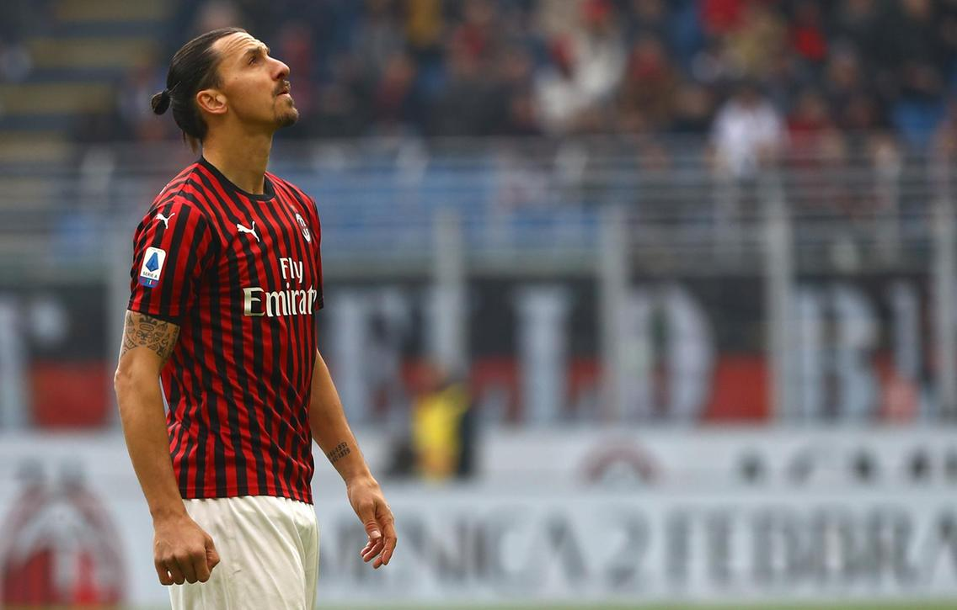
APPLICATIONS
There are many applications of the project :
Through this app every football fan in India can become aware of the happenings in European football.
Every football fan will have a sound knowledge of European competitions despite being in India.
The latest news I.e match information will be provided as soon as possible.
Offline availability .
Huge database containing past as well as present match information facilitates large amount of matchdays to choose from.

Slide 10
A LITTLE ABOUT JAVA
Java is a general-purpose, concurrent, class-based, object-oriented computer programming
language that is specifically designed to have as few implementation dependencies as possible. It
is intended to let application developers "write once, run anywhere" (WORA), meaning that code
that runs on one platform does not need to be recompiled to run on another. Java applications are
typically compiled to byte code (class file) that can run on any Java virtual machine (JVM)
regardless of computer architecture

Slide 11
Java is, as of 2012, one of the most popular programming languages in use, particularly for client-server web applications, with a reported 10 million users
[1][2]. Java was originally developed by James Gosling at Sun Microsystems (which has since
merged into Oracle Corporation) and released in 1995 as a core component of Sun Microsystems'
Java platform. The language derives much of its syntax from C and C++, but it has fewer low
level facilities than either of them. Java [3] can be used to write applications and applets. A Java application is similar to any other high-level language program: It can only be compiled and then run on the same machine.

Slide 12
An applet is compiled on one machine, stored on a server in binary, and can be sent to another
machine over the Internet to be interpreted by a Java-aware browser. Java comes with a large
library of ready-made classes and objects. The key difference between Java 1.0 and 1.1 was in
this library. Similarly, Java 2.0 has a very much larger library for handling user interfaces (Swing
by name) but only small changes to the core of the language.

Slide 13
LITERATURE SURVEY
In this project we have used javafx with the combination of scene builder which gives a perfect platform for building an application, i.e (UEFA News) which gives the idea about the main two competitions held in the world of football which is Europa league and the Champions league. This is like getting an overview of the matches held in the tournament in a very short moment of time.
So to perform this task we have used the java langauge with javafx platform and to enhance it scene builder is used with the help of Intellij IDE .

Slide 14

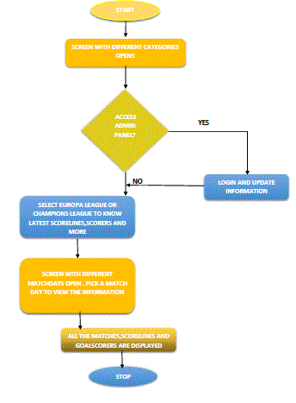
FLOWCHART

Slide 15
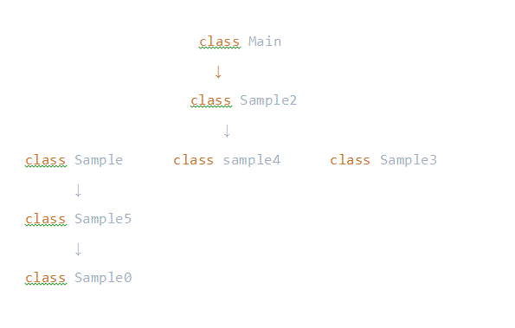
CLASS HIERARCHY
\

Slide 16
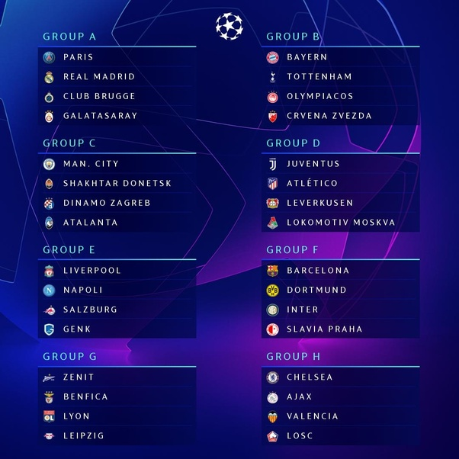
UCL GROUPS 2020

Slide 17
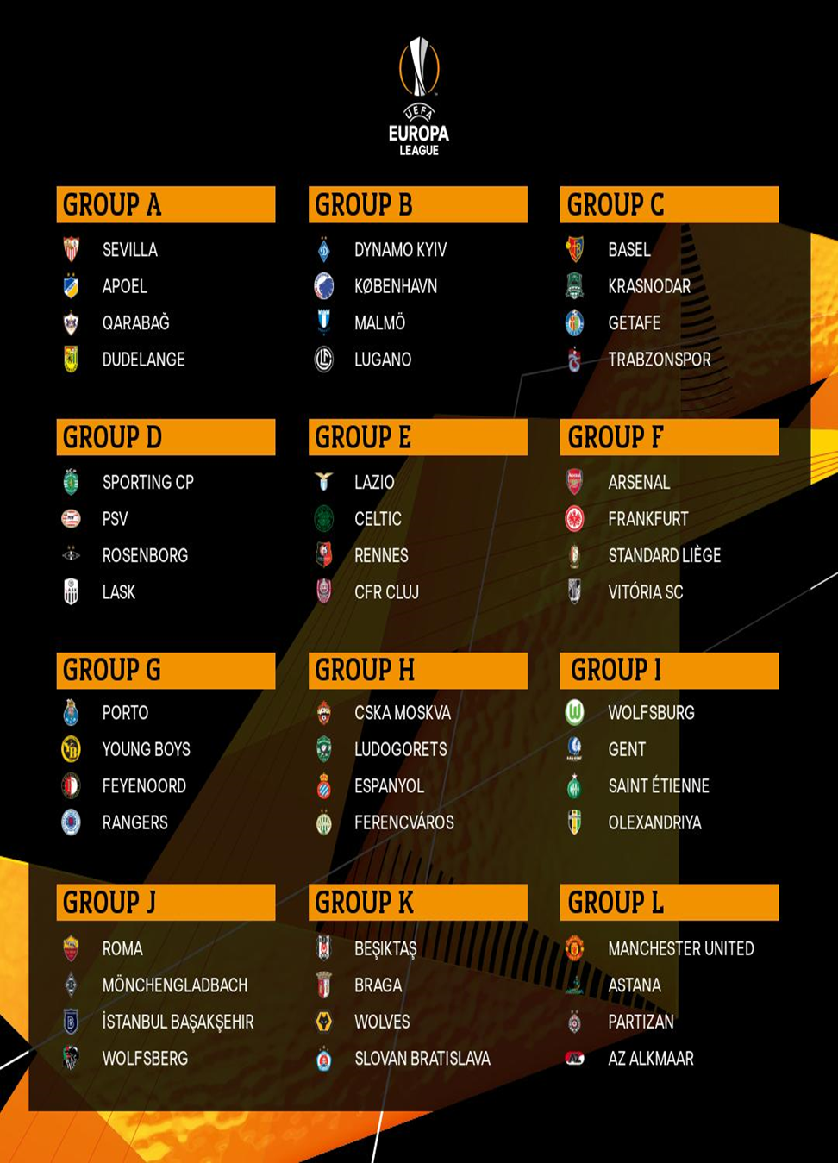
UEL GROUPS 2020

Slide 18


WORKING
As mentioned the home page opens revealing 3 options for us to choose from in addition to an exit button.

Slide 19
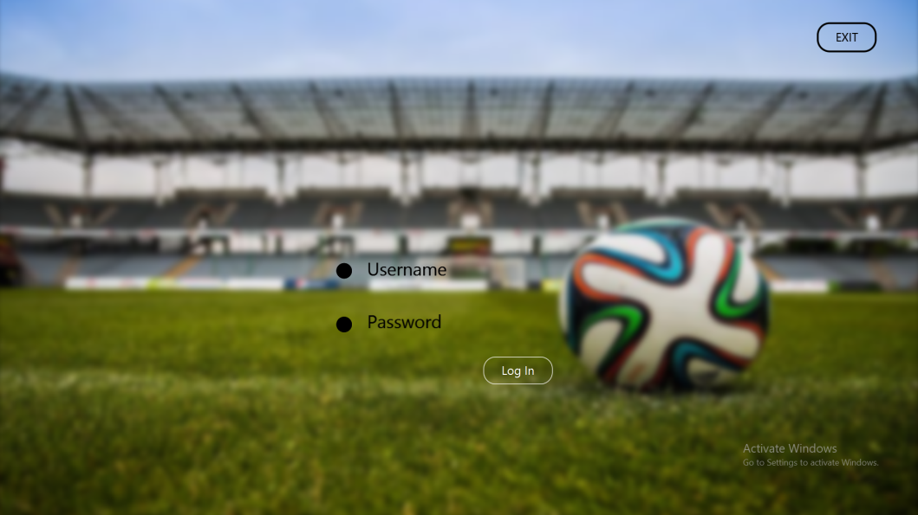
Upon choosing admin panel we are then taken to the next page where we are asked for our username and password.
we can also choose the exit option

Slide 20
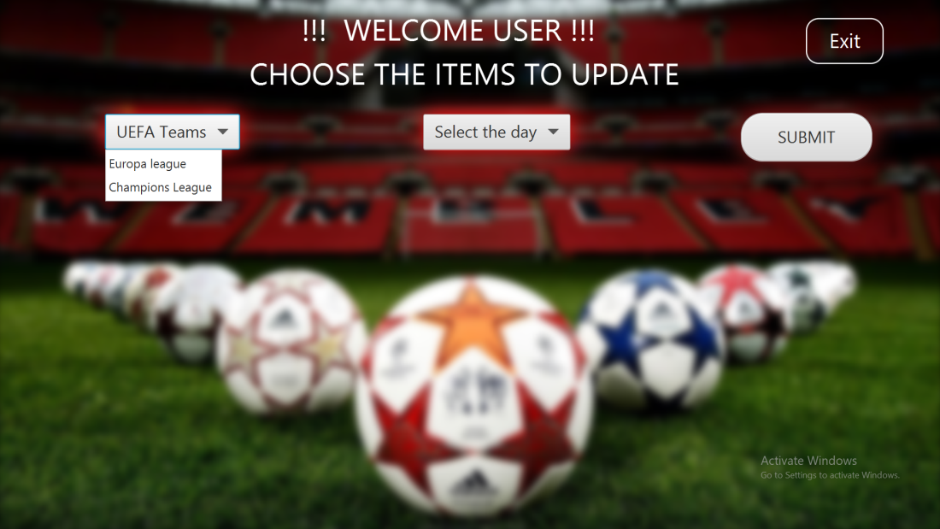
Then the next page opens welcoming the admin to update the information by selecting the competition I.e either Champions league or Europa league and the matchday .

Slide 21
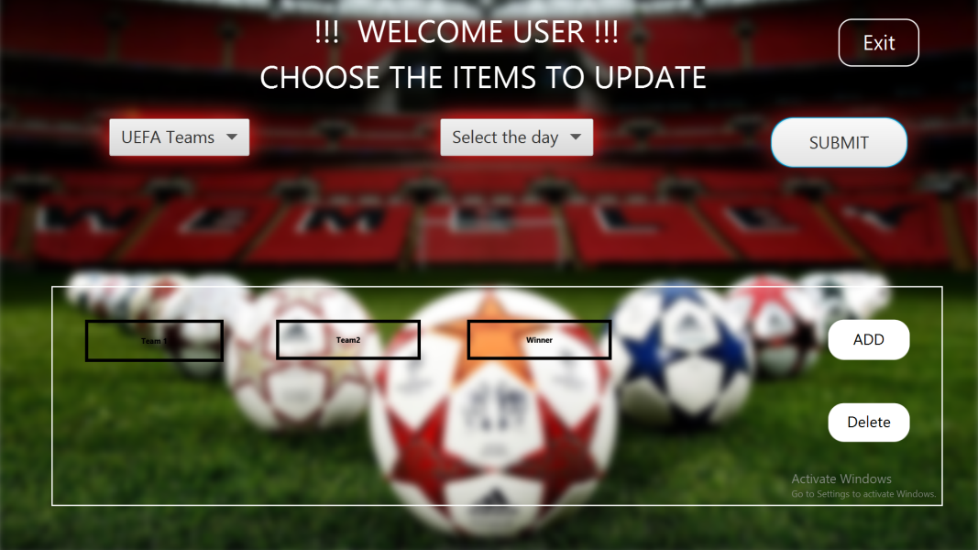
User then adds the information to be updated i.e both the teams and the result. User then selects whether to add the information or delete it.

Slide 22
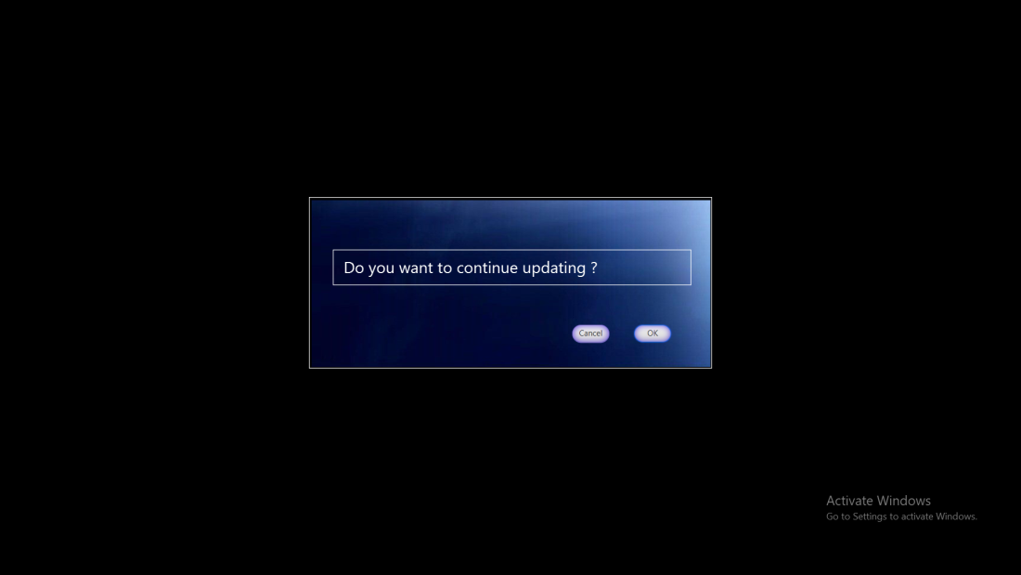
After updating a dialogue box appears prompting the user to either continue updating or go back to home page.

Slide 23
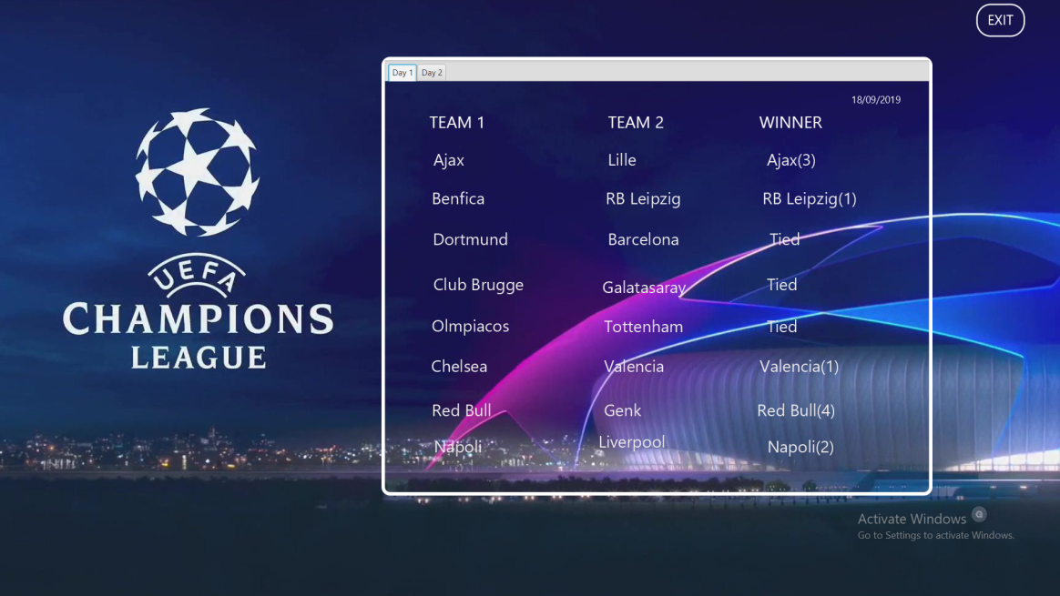
After reaching the home page if you pick champions league, next page will open with champions league results of each matchday . You can toggle between the tabs to switch the matchday .

Slide 24
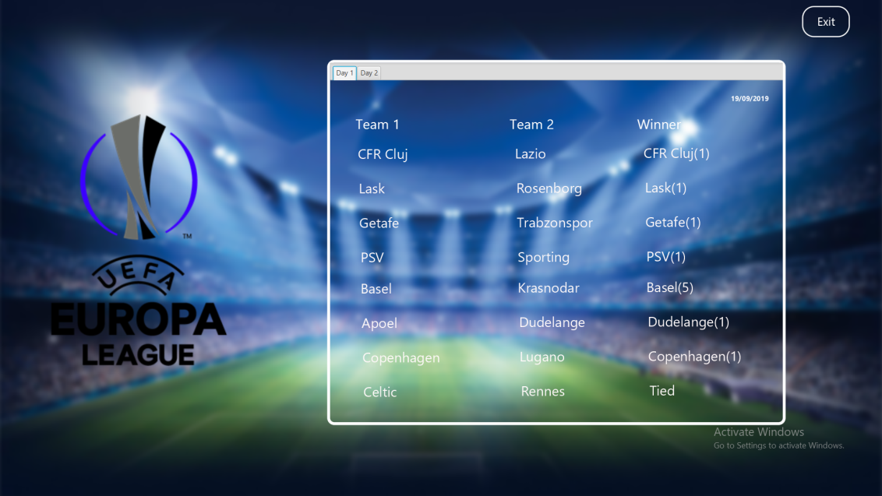
Similarly one can view Europa league results as well by toggling between the matchday tabs.

Slide 25
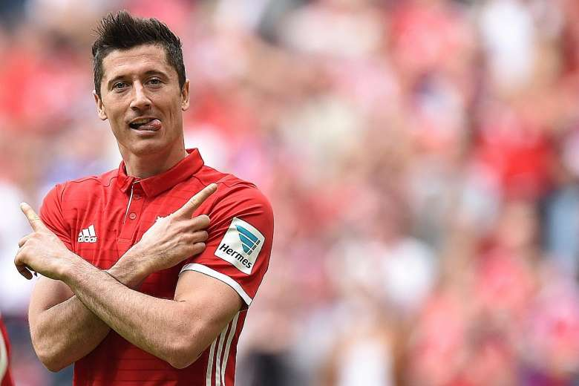
APPLICATIONS USED
JavaFX
MySQL

Slide 26
HARDWARE REQUIREMENTS
Windows
Windows 10 (8u51 and above)
Windows 8.x (Desktop)
Windows 7 SP1
Windows Vista SP2
Windows Server 2008 R2 SP1 (64-bit)
Windows Server 2012 and 2012 R2 (64-bit)
Disk space: 124 MB for JRE; 2 MB for Java Update
Processor: Minimum Pentium 2 266 MHz processor
Browsers: Internet Explorer 9 and above, Firefox

Slide 27
Linux
Oracle Linux 5.5+1
Oracle Linux 6.x (32-bit), 6.x (64-bit)2
Oracle Linux 7.x (64-bit)2 (8u20 and above)
Red Hat Enterprise Linux 5.5+1, 6.x (32-bit), 6.x (64-bit)2
Red Hat Enterprise Linux 7.x (64-bit)2 (8u20 and above)
Suse Linux Enterprise Server 10 SP2+, 11.x
Suse Linux Enterprise Server 12.x (64-bit)2 (8u31 and above)
Ubuntu Linux 12.04 LTS, 13.x
Ubuntu Linux 14.x (8u25 and above)
Ubuntu Linux 15.04 (8u45 and above)
Ubuntu Linux 15.10 (8u65 and above)

Slide 28
PROJECT SUMMARY
UEFA NEWS is a Java project for 4th semester where we use JavaFX and MySQL to create an application for various football fans to keep them informed and updated on the current proceedings of the worlds biggest club competitions the UEFA Champions League and UEFA Europa League. The huge database also allows offline access as well as huge collection of matches to choose your results from.

Slide 29
CONCLUSION
1. The aim of our project is to make every football fan in India aware of the happenings in European football.
2. We want every football fan to have a sound knowledge of European competitions despite being in India .
3. We want to eliminate all the difficulties faced by Indian fans and provide them with the news as soon as possible.
4. Through this project we were able to explore deeper which resulted in a greater understanding for each one of us and were able to achieve our target.

Slide 30


